Slide 1
Halal Ingredient Analysis
By Rasyidah, DSIF-SG-11

Slide 2
Table of contents
01
02
03
04
Introduction
Problem Statement
Objective
Data
Workflow, Data Collection, Data Processing
Using OpenAI,
Fine Tuning
Feature Engineering
Conclusion
Final Thoughts
Future Developement

Slide 3
01
Introduction

Slide 4
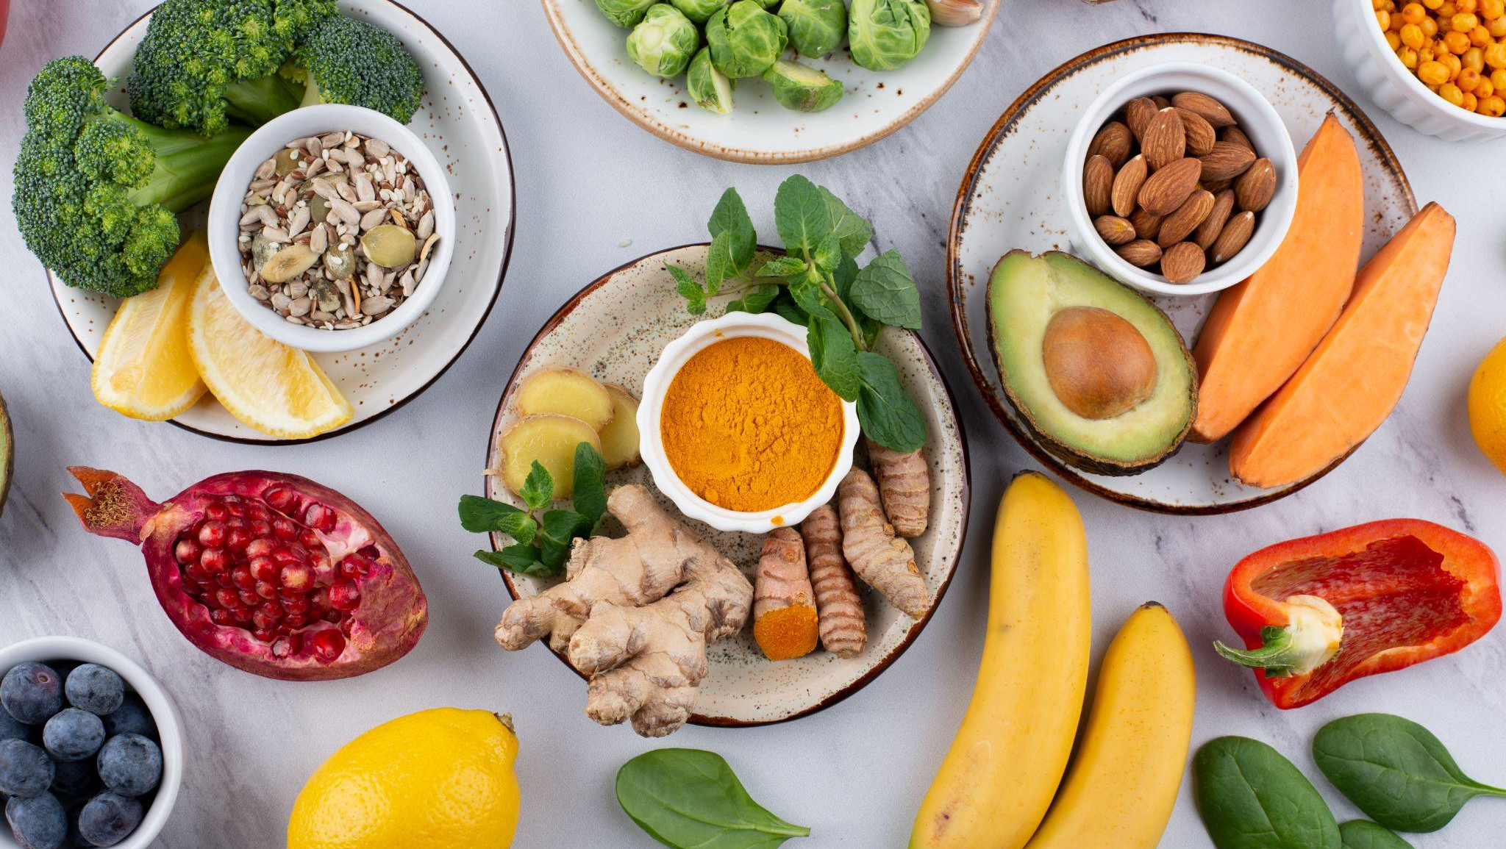
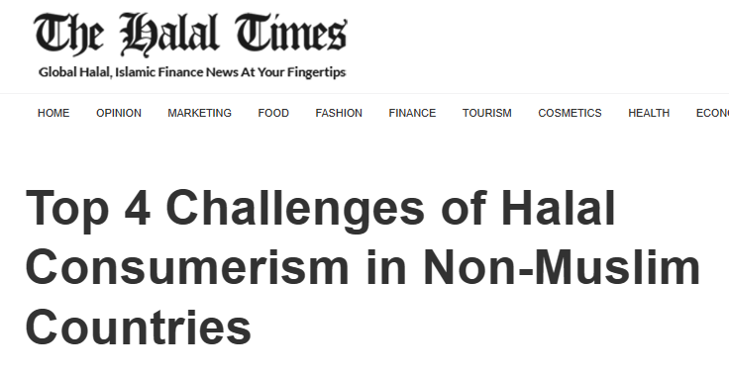
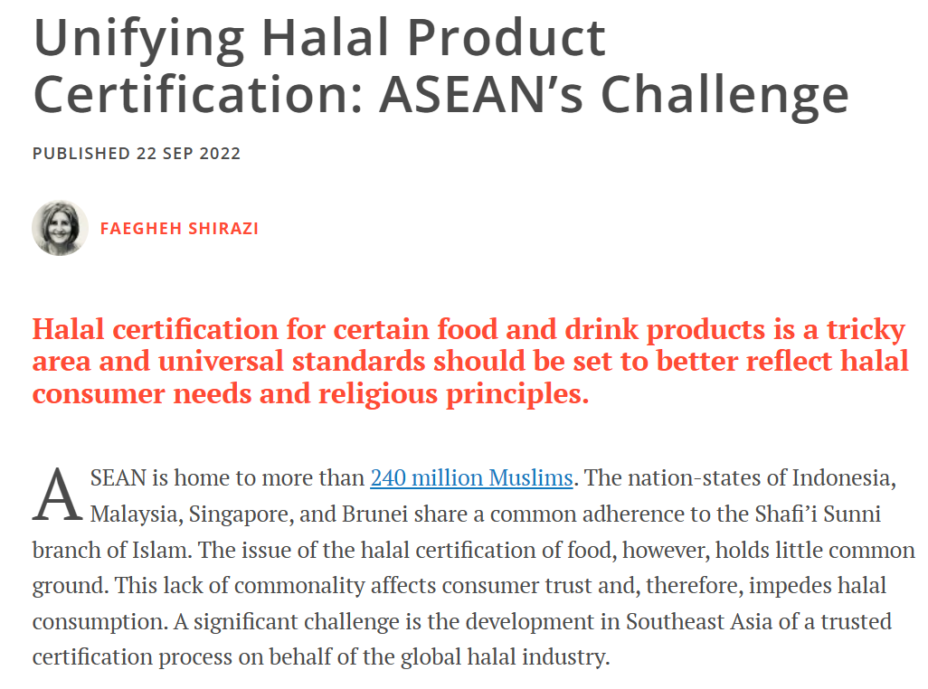
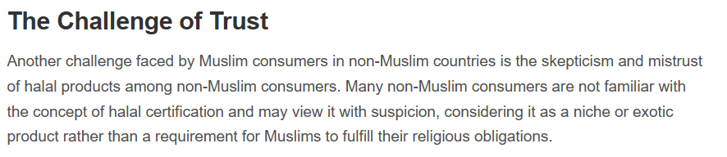
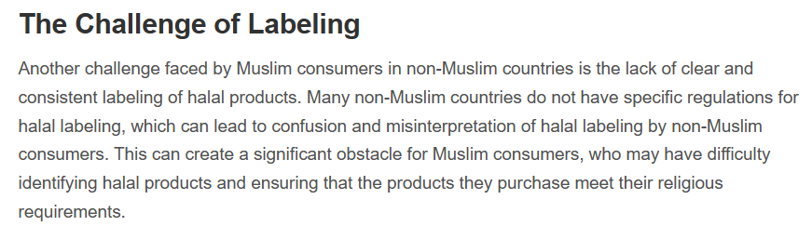
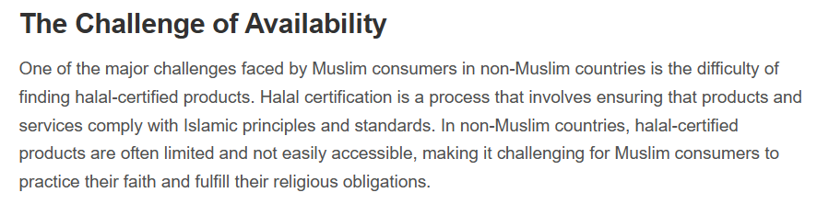
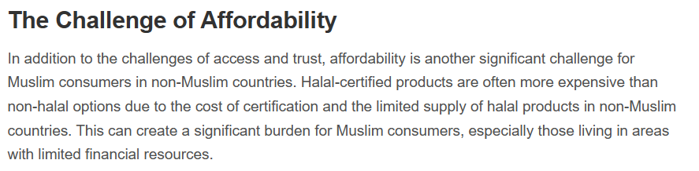

Slide 5
What is halal?

Slide 6
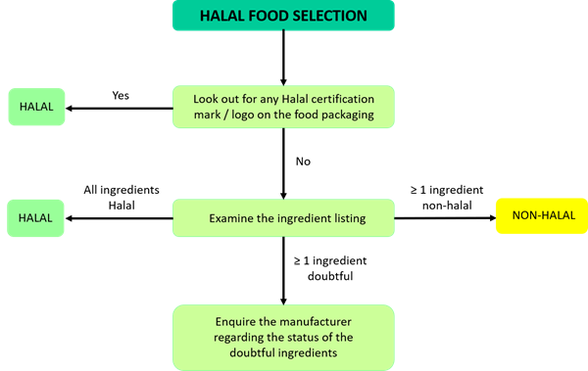
Halal Food Selection

Slide 7
Problem Statement
Develop an automated system to determine whether food products are halal or not by analyzing and interpreting their ingredients, particularly when purchasing products overseas.

Slide 8
Objectives
Create a model to classify food as halal, non-halal or doubtful
Ingredients not in database will be checked through OpenAI
Accessible Information
Enhancing the ability of consumers, especially Muslims, to make informed choices when purchasing food items abroad.

Slide 9
Success Metrics
Answer Relevancy
Measures how relevant the generated answer is to the question
Faithfulness
Measures how accurate the generated answer, hallucinated or factuality

Slide 10
Data
02
Workflow, Data Collection, Data Processing

Slide 11
Data Sources
MUIS Website | Food and Drink Categories | Food Selection | Food Preparation | Food Additive Listing
World of Islam | Food Additive List
Islamcan.com | Halal Haram Database

Slide 12
Data Dictionary
ingred_name | Code or short identifier for each ingredient.
chem_name | The chemical name of the ingredient.
description | A brief description of the ingredient, indicating its use or properties.
halal_non_halal_doubtful | Numerical value indicating the halal status: 0 for Halal, 1 for Non-Halal, 2 for Doubtful.

Slide 13
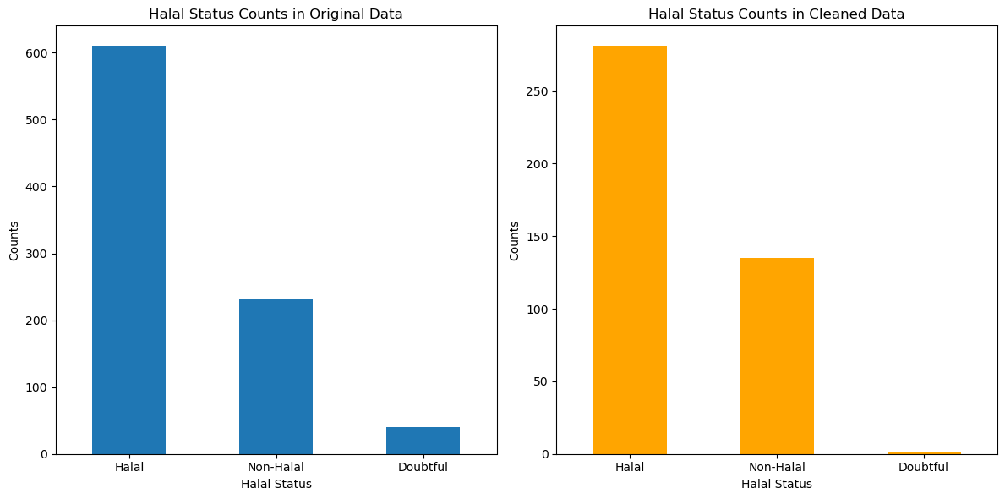
Value Counts on Ingredients
610
281
Total count for each category after dropping the rows with no description
Total counts of each catergory
135
232
40
1

Slide 14
Project Workflow
Halal Status Check
Backend Processing
Data Collection on Ingredients
Text Extraction
Image Capture
Fine tuning
Handling Unknown Ingredients
Notes:
Data Collection on Ingredients - Collect and compile data on halal, non-halal, and doubtful ingredients.
Image Capture - Capture images of products and their ingredient labels.
Text Extraction - Implement text detection on images to identify and print the list of ingredients.
Handling Unknown Ingredients - ingredients not found in compiled list is processed through Open AI model to determine if they are halal’
Halal Status Check - Compare the ingredients extracted from images against the pre-compiled list.
Backend Processing - Perform backend processing to enhance the accuracy and efficiency of the system.
Fine tuning - Fine-tune the chat model to improve interaction and response quality regarding halal ingredient queries.

Slide 15
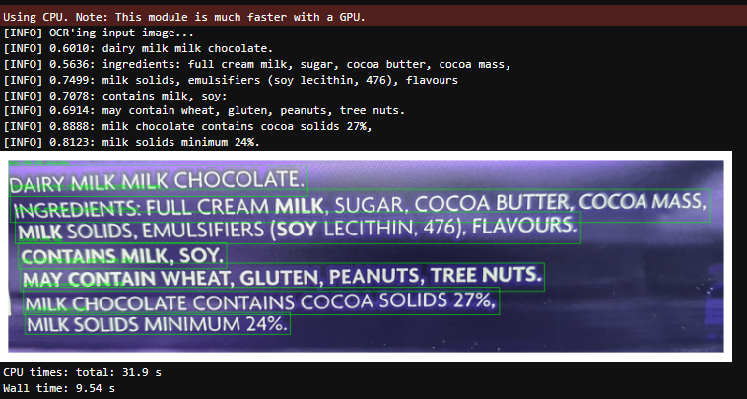
Ingredients are detected correctly

Slide 16
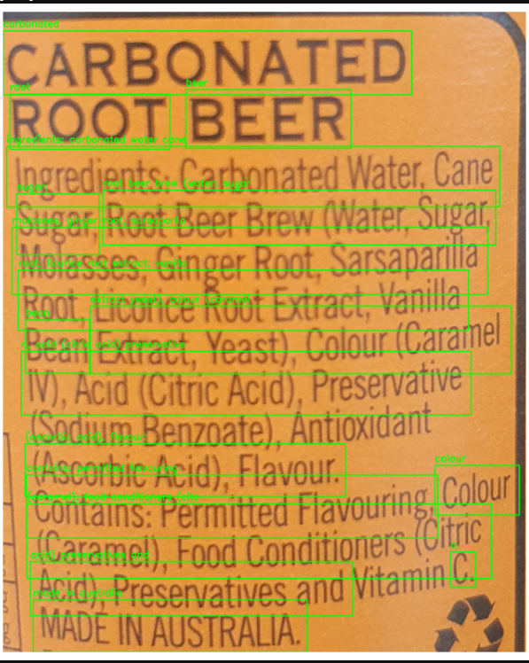
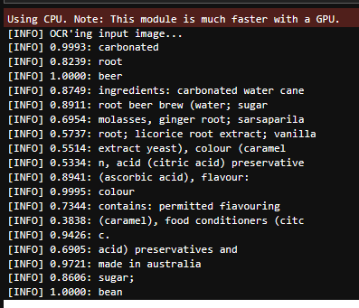
Easy OCR
Ingredients text poorly detected

Slide 17
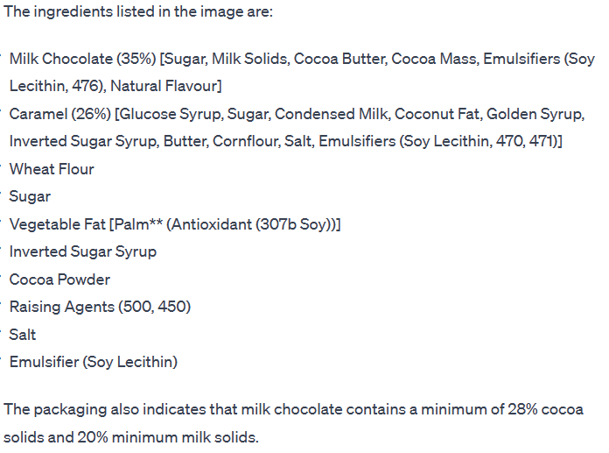
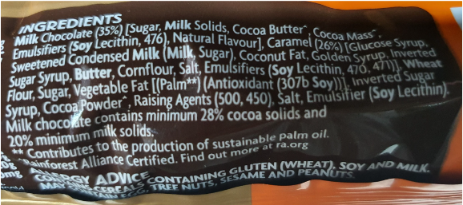
GPT-4 Vision
preview
Images are passed through the model via url or the base64 encoded image

Slide 18
03
Feature Engineering
GPT Open Ai Model

Slide 19
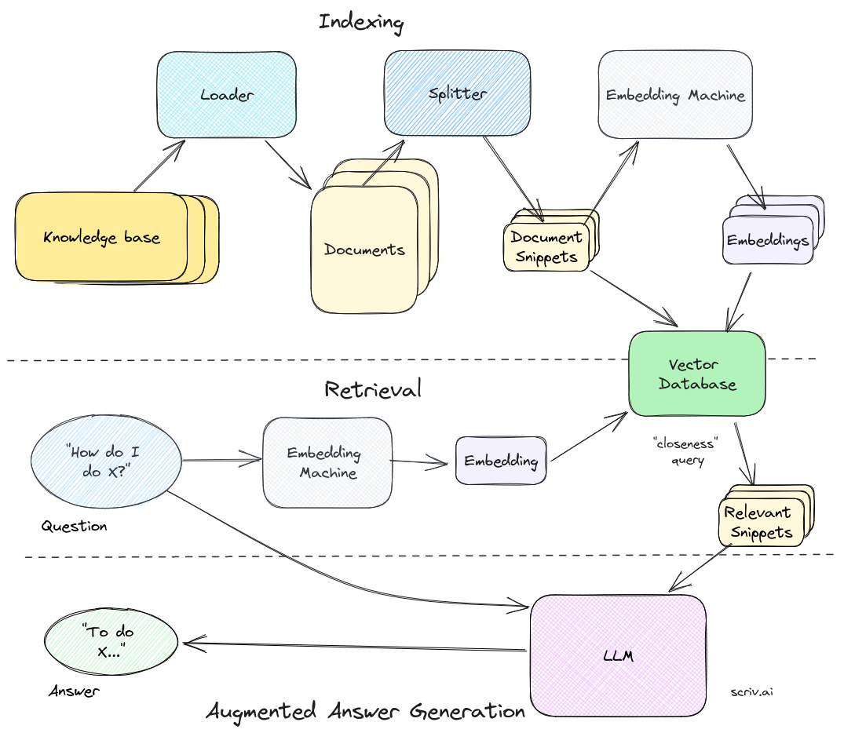
Retrieval- Augmented Generation
(RAG) pipeline
How do domain-specific chatbots work? An Overview of Retrieval Augmented Generation (RAG) | Scriv

Slide 20
General Task Overview
question_gen_query = (
"Given your expertise in Halal food certification, I need you to analyze the ingredients of a specific food product for Halal compliance. Please provide a clear and detailed assessment for each ingredient based on the information available in the provided documents. Consider factors such as the source and processing methods of each ingredient, as these can impact its Halal status. If any ingredient is non-Halal, doubtful, or lacks sufficient information for assessment, please categorize the entire food product accordingly. Your goal is to determine the overall Halal status of the food product. Please provide concise and factually accurate responses."
)

Slide 21
Detailed Task Instruction
Question_gen_query = "As an expert in halal food certification, your task is to meticulously analyze the ingredients of food products. "
"A user is looking to determine if a specific food product is halal. "
"For each ingredient listed in a product, provide a detailed assessment based on the information available in the uploaded documents. "
"Some ingredients may have different halal statuses depending on their sources or processing methods. "
"Evaluate each ingredient to determine if it is halal, non-halal, or doubtful. "
"Consider the source and processing of each ingredient, as this can influence its halal status. "
"Your goal is to ensure that each ingredient in the product is halal. If any ingredient is non-halal, doubtful, not identifiable, or lacks sufficient information to ascertain its halal status, then the entire food product should be considered non-halal. "
"Provide a conclusive assessment for each ingredient, thereby determining the overall halal status of the food product."

Slide 22
Success Metrics
Prompts | Models | Answer Relevancy | Faithfulness
General | ft:gpt-3.5-turbo-1106 | 0.969 | 0.8
General | gpt-3.5-turbo-0613 | 0.9591 | 0.75
Task Oriented | gpt-3.5-turbo-0613 | 0.944 | 0.6
Task (CSV,pdfhtm) | gpt-3.5-turbo-0613 | 0.961 | 0.55

Slide 23
04
Conclusion

Slide 24
Conclusion
Effective in Simple Ingredient Detection:
performs efficiently in identifying basic ingredients,
demonstrating its effectiveness in simpler scenarios of ingredient analysis.
Optimal Model Performance:
Gpt-3.5-turbo-1106
Formulation of prompts, a pivotal role in influencing model performance

Slide 25
Future Developments
Streamlining Phrase Recognition for removal
Detailed Analysis of Sub-Ingredients
Enhancing the Precision of Halal Status Determination
Ongoing Model Improvement
Incorporating User Feedback

Slide 26
Thanks!
Please keep this slide for attribution

Slide 27
Q & A

Slide 28
References
Here’s an assortment of alternative resources whose style fits that of this template:
Vectors:
Top 4 Challenges of Halal Consumerism in Non-Muslim Countries - The Halal Times
Unifying Halal Product Certification: ASEAN’s Challenge | FULCRUM
Halal consumerism from a wider perspective (nst.com.my)

